Slide 1
English-section 1
SELF INTRODUCTION

Slide 2
What is self introduction?
Self introduction is a way to share about who you are.

Slide 3
What things can you share to others?
Name
Address
Date of birth
hobby
Nationality
And what others need to know about you

Slide 4
When does it happen?
It happens when you meet new people or circumstance.

Slide 5
How to introduce yourself?
Here are some ways that we can use to introduce ourselves;
May I introduce myself?
My name is dinda putri
My nickname is dinda
2. Hi… I am sarah, and you?
3. friends, I would like to introduce myself. My name is …….

Slide 6
Grammar focus
Simple present tense is used to state ourselves.
Pattern: s + v1 + o
s → (I, you, they, we)
s + v1_{s/es} + o
s→ (he, she, it)
Example;
People call me Jason.
I live in bali.
I adore my mother. She really likes cooking.

Slide 7
Simple present tense with to be
Pattern:
s + to be (is, am are) + o
Example:
I am from japan.
My favorite actor is brad pitt.
My house is small and clean.
I have two sisters. They are cute and smart.

Slide 8
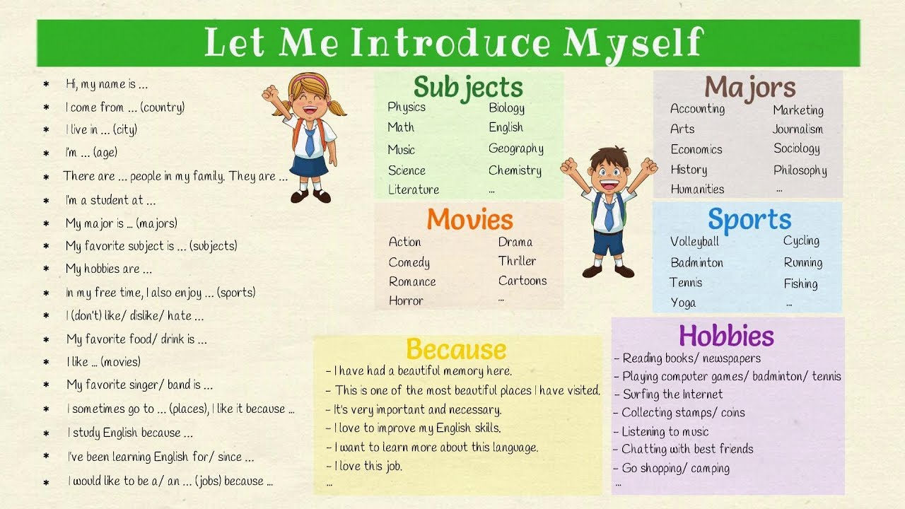

Slide 9
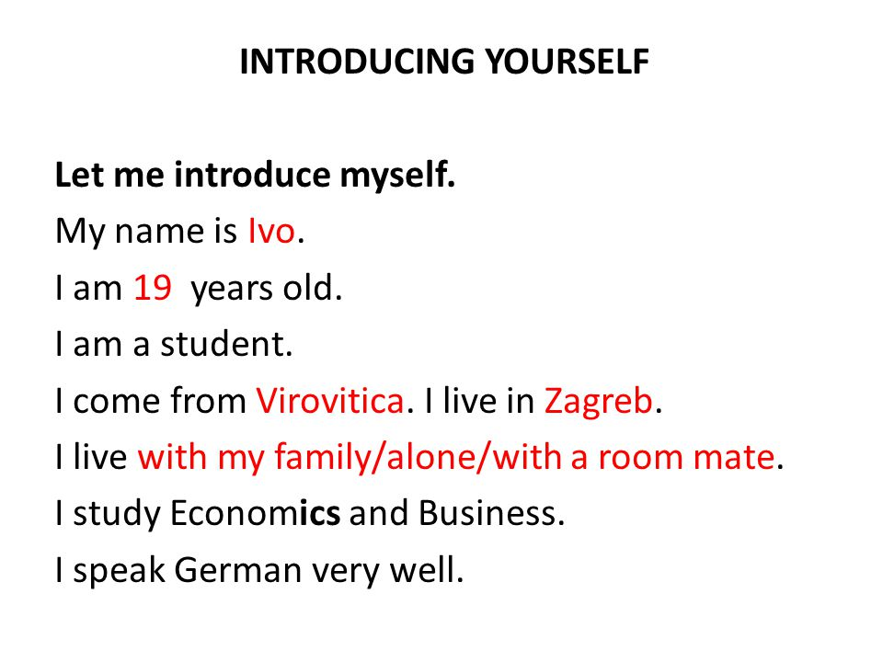

Slide 10
Now, it’s your turn to introduce yourself!

